Slide 1
Lucky café shop
MADE BY CSIPET TEAM

Slide 2
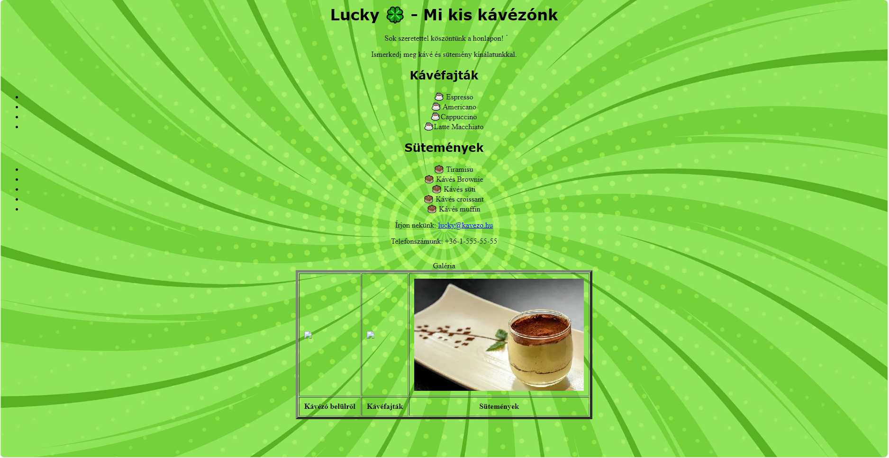
Requirements of the customer
Old webpage:

Slide 3
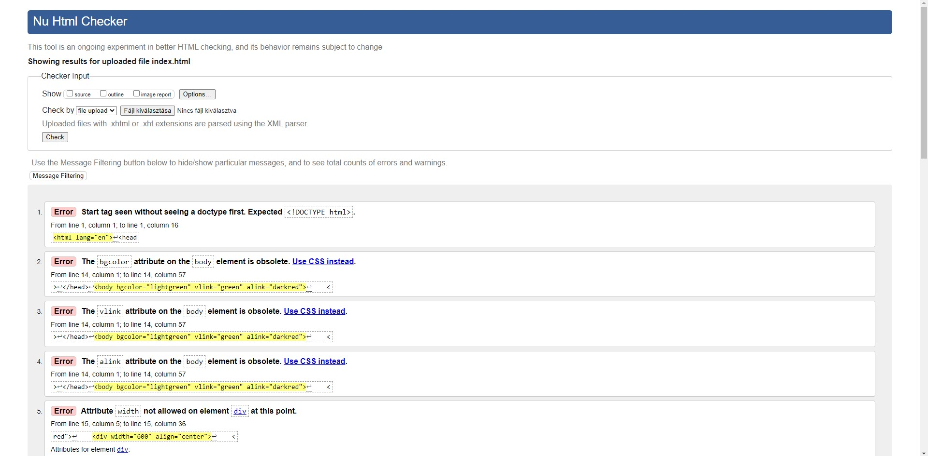
Requirements of the customer
Validation:

Slide 4
Introduce the crew
Zsiros Máté Ferenc:
Living place: Palotás
Date of birth: 2005. 05. 11.
Position: HTML, JavaScript and CSS developer

Slide 5
Introduce the crew
Tóth Bence:
Living place: Budapest
Date of birth: 2003. 06. 25.
Position: HTML and CSS developer (graphic designer)

Slide 6
Introduce the crew
Kovács Zétény:
Living place: Budapest
Date of birth: 2004. 07. 08.
Position: HTML developer, project manager and graphic designer

Slide 7
Introduce the crew
Kiss Benedek:
Living place: Budapest
Date of birth: 2004. 09. 06
Position: HTML developer and

Slide 8
Introduce the crew
Chat GPT:
Appearance: 2022. 11. 30.
Position: virtual assistant

Slide 9
Planning
Prototype: A picture that shows how will look like the webpage at the begin. It shows the header and the other parts of the page, to see how much space left.

Slide 10
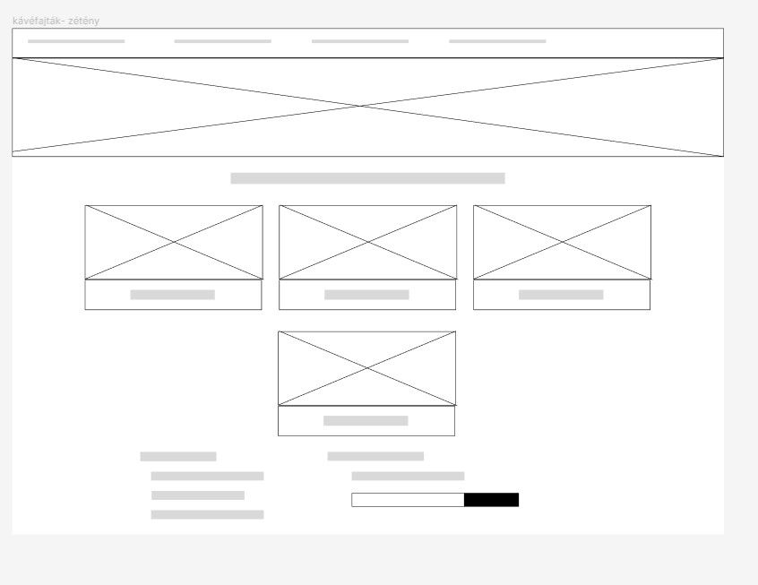
Picture about the wireframe

Slide 11
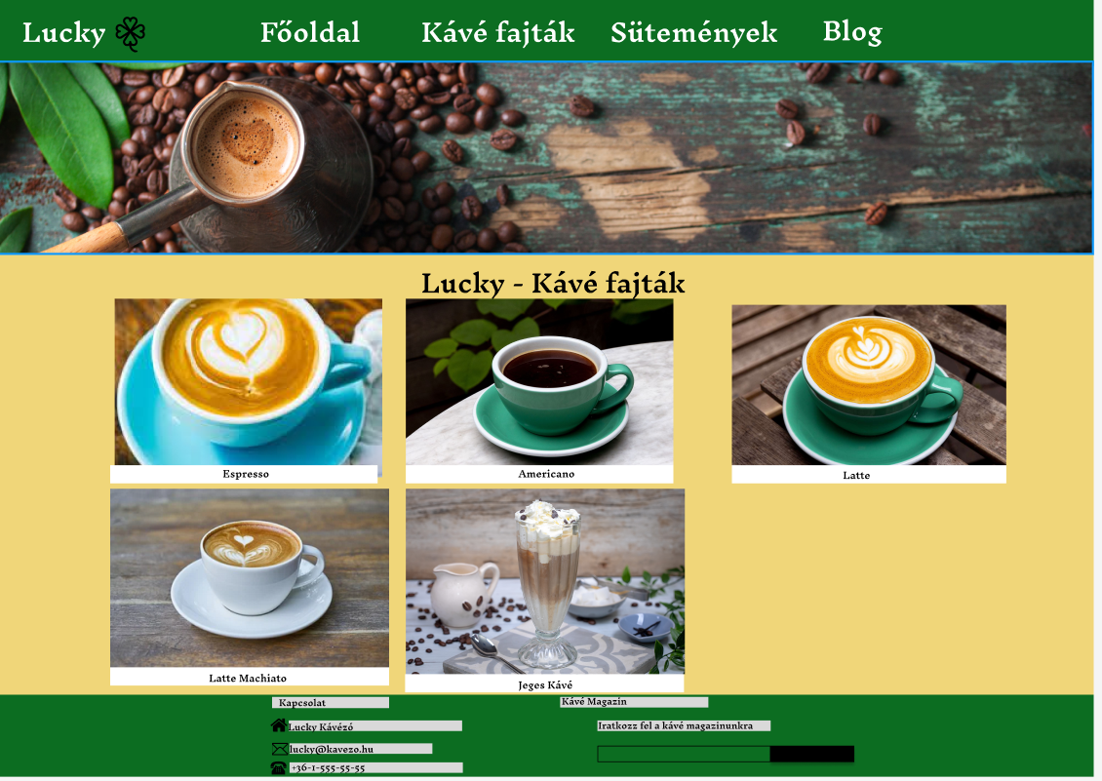
Picture about prototype

Slide 12
Tools
Trello: In this website we share who whcich work will do, and we can change the job status that still in progress or finish. We can also give deadline to the works.

Slide 13
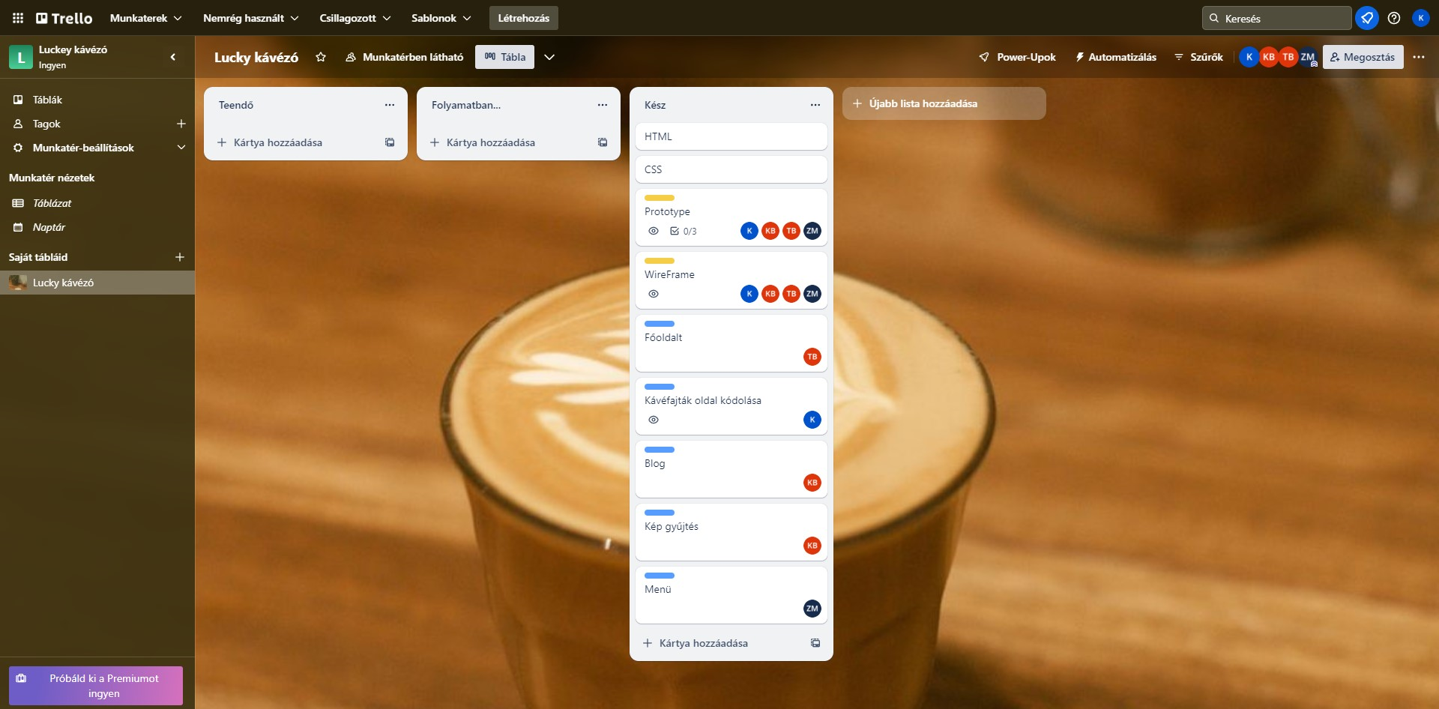
Picture about the trello

Slide 14
Tools
Github: We upload to this website the HTML, CSS and JavaScript files and also the pictures for that.

Slide 15
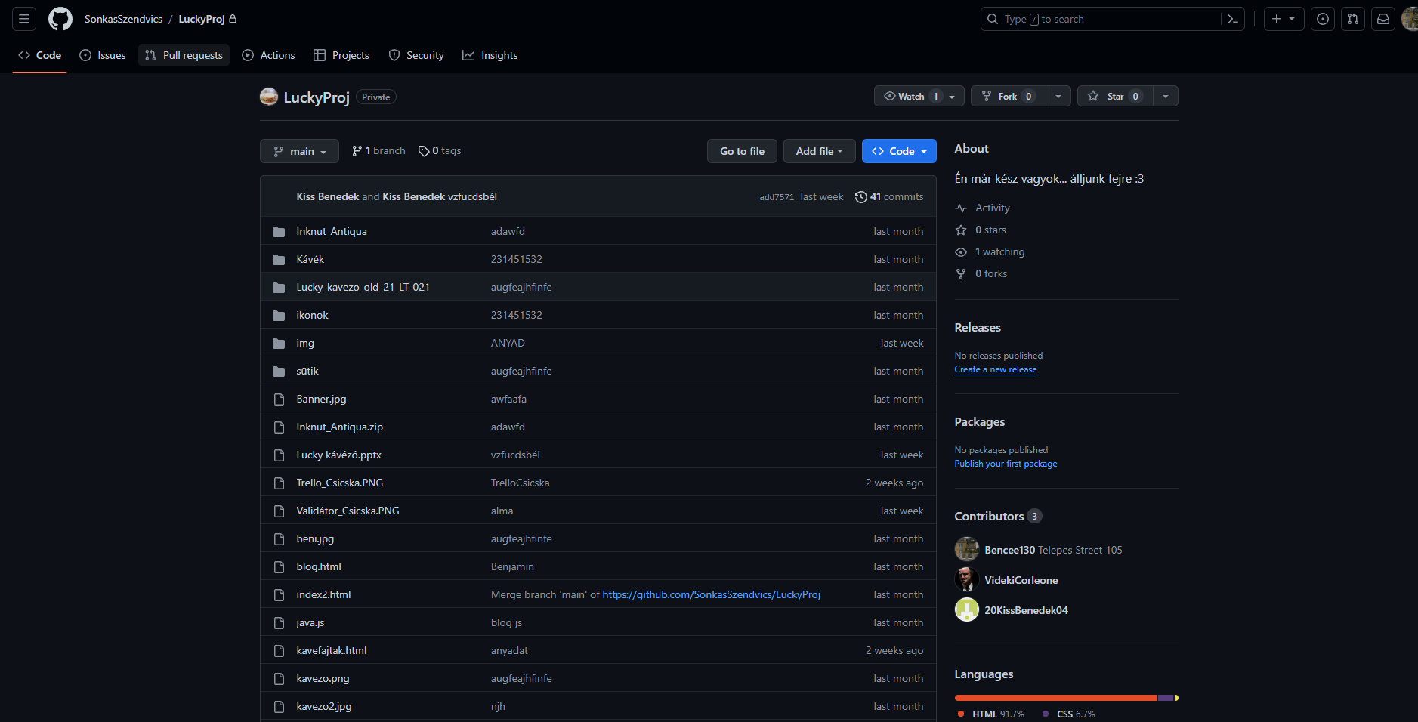
Picture about the github

Slide 16
Lucky Café project
The project was to make a webpage about a Café shop. The webpage should contains a mainpage, cakes, coffees and a blog page.
Comment: The customer would like to pay with Bitcoin.

Slide 17
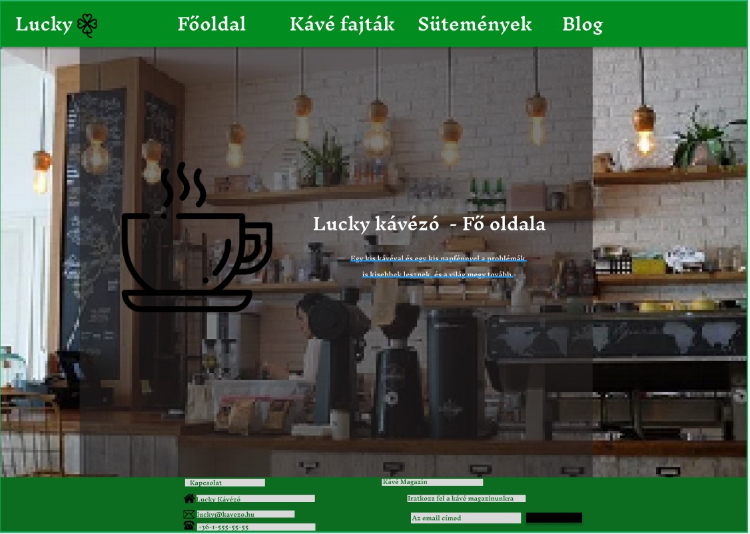
Mainpage

Slide 18
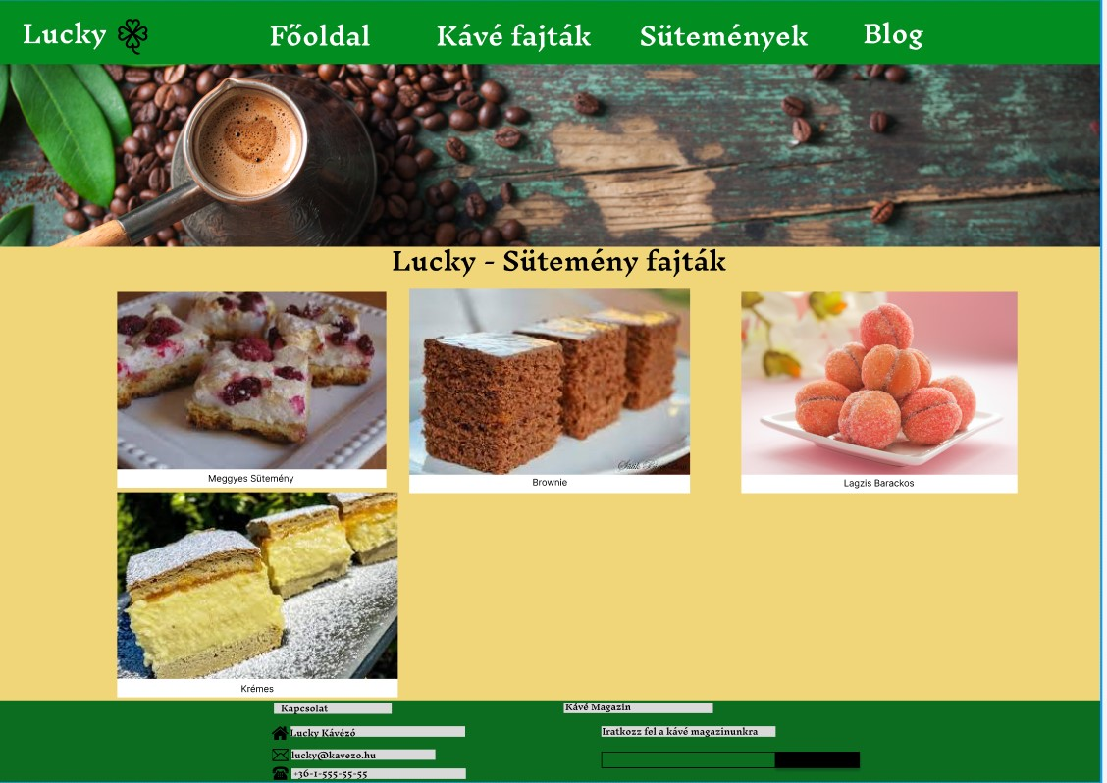
Cakes page

Slide 19
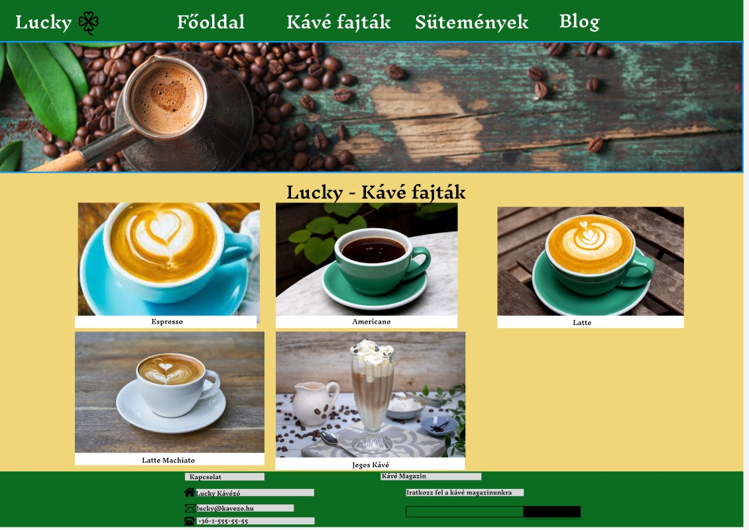
Caffee page

Slide 20
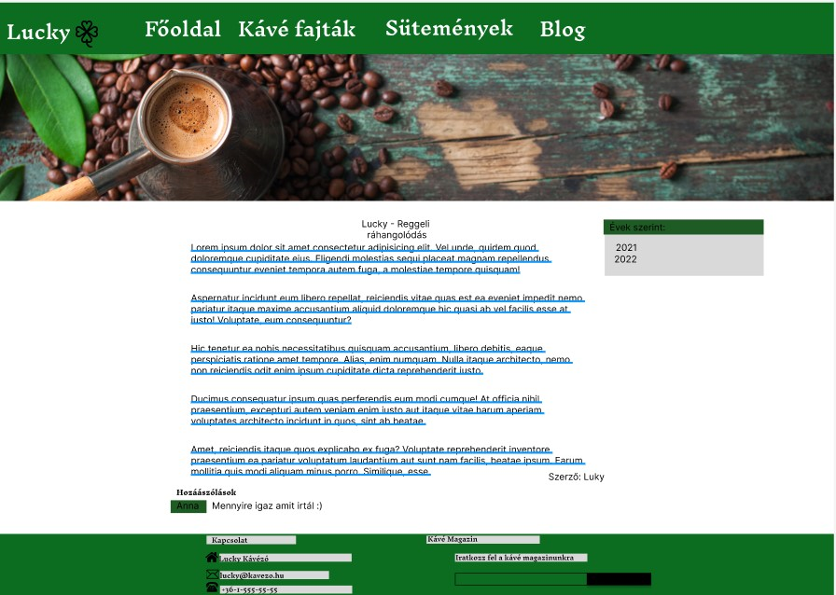
Blog page

Slide 21
Github link
Project fájlok

Slide 22
Thank you!

